Slide 1
Bank Loan Analytics
By Group 4

Slide 2
Dataset Used
Domain : Finance
Project: Bank loan of customers
Datasets: Finance_1.xlsx & Finance_2.xlsx
Dataset Type: Excel file , CSV file
Dataset Size: Each Excel file has 39k+ records

Slide 3
About the Project
Introduction
Data cleaning
Data Visualization
Observation
Conclusion

Slide 4
Bank loan Analysis
Provide Clarity:-
The primary goal of this presentation is to shed light on the intricate dynamics of our loan data. Our goal is to find insightful information through in-depth analysis that can guide strategic planning and well-informed decision-making.
Enlighten Decision:-
Making Through analyzing several facets of our loan portfolio, we hope to provide stakeholders with the information they need to make informed decisions. These choices could involve everything from client segmentation techniques to risk management plans.
Optimize Lending Practices:-
By seeing trends, patterns, and correlations in the data, we hope to improve our lending procedures. We can improve client satisfaction, streamline our operations, and boost overall business performance by comprehending the fundamental factors that influence loan performance.

Slide 5
Data Cleaning
For better understanding, we convert null=0 in integer column
using replace function.
Delete unwanted column from dataset / given file
Round up the values , using round function
Change date format according to requirement

Slide 6

Data Visualization
Data visualization by KPI’s
Year wise loan amount stats
Grade and subgrade wise revol_bal
Total payment for verified status and not verified status
State wise n month wise loan status
Home ownership vs last payment date stats
Class | Group 1 | Group 2
Class 1 | 82 | 95
Class 2 | 76 | 88
Class 3 | 84 | 90
This Photo by Unknown Author is licensed under CC BY

Slide 7
Year Wise Loan Amount Overall, there's a consistent increase in loan disbursements over the years, indicating growth in the lending business.

Slide 8
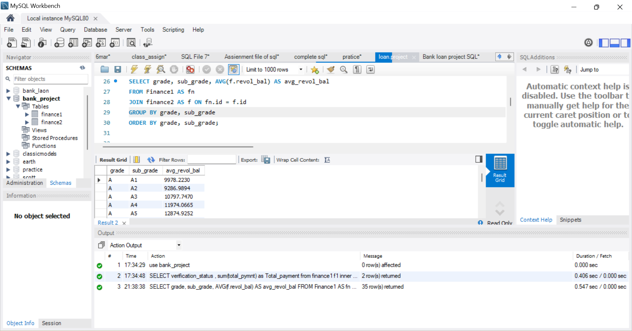
Grade And Subgrade Wise Balance :- Higher-grade loans tend to have lower revolving balances compared to lower-grade loans, suggesting better credit management among borrowers with higher creditworthiness.

Slide 9
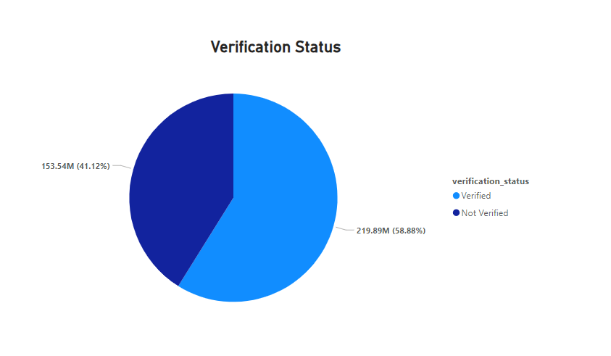
KPI- 3
This observation suggests that verified borrowers may be more financially stable or have better creditworthiness, resulting in more reliable repayment behavior.
Loans with verified status typically have higher total payments compared to those without verification.

Slide 10
KPI-4
Step 1 Title
Task description
Step 2 Title
Task description
Step 3 Title
Task description
Task description
Task description
Task description
Step 4 Title
Task description
Task description
Task description
Task description

Slide 11
KPI-5
Analyzing this relationship can inform segmentation strategies and risk assessment models, potentially leading to more accurate credit decisions.
Borrowers with different home ownership statuses may have varying last payment dates.

Slide 12
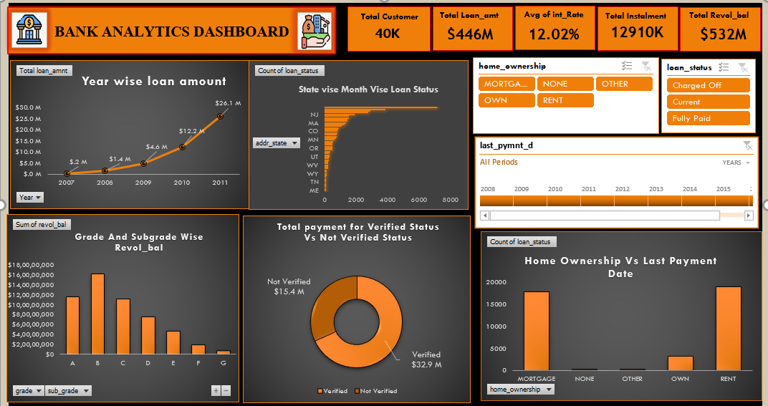
Report
This dashboard report provides a comprehensive overview of bank loan management, encompassing key metrics and trends essential for strategic decision-making. Through rigorous analysis, several insights have been gleaned:

Slide 13
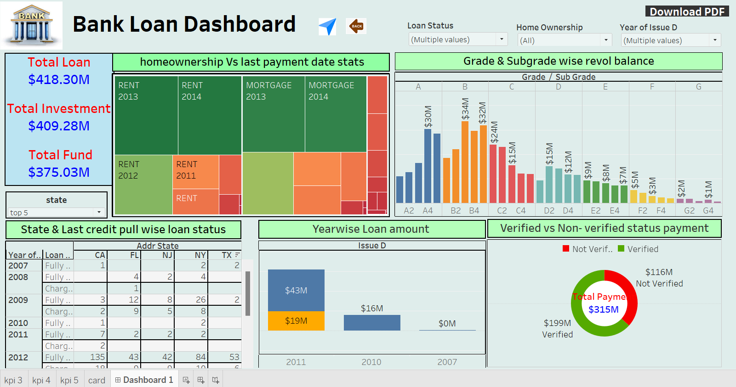

Slide 14
Observation
Overall, there's a consistent increase in loan disbursements over the years, indicating growth in the lending business.
Higher-grade loans tend to have lower revolving balances compared to lower-grade loans, suggesting better credit management among borrowers with higher creditworthiness.
This observation suggests that verified borrowers may be more financially stable or have better creditworthiness, resulting in more reliable repayment behavior.
Loan status varies across states and months, indicating regional and temporal differences in loan performance.
Analyzing this relationship can inform segmentation strategies and risk assessment models, potentially leading to more accurate credit decisions.
Overall, these observations provide valuable insights into loan portfolio performance, credit risk, and borrower behavior. They can guide strategic decision-making, risk management efforts, and product development initiatives aimed at optimizing profitability and minimizing credit losses.

Slide 15
Conclusion
Tracking year-wise loan amounts helps in forecasting future loan demand and planning resource allocation accordingly.
Analyzing revolving balances by grade and subgrade provides insights into credit utilization patterns among different borrower segments.
Monitoring total payments based on verification status helps in evaluating the effectiveness of verification processes in mitigating credit risk.
By offering personalized support and assistance to homeowners facing financial challenges, lenders can improve repayment rates and overall portfolio performance.

Slide 16

Thank you ☺
I sincerely appreciate your time and attention today.
Thank you for joining me as we explored the world of user-defined functions in MySQL.

